Slide 1
Condominiums
Does a property’s market value change by Neighborhood?

Slide 2

How Market Value is determined for Properties in New York City and Why
How?
Why
Uses of Market Value
The Department of Finance of NYC, has a formula that makes use of the incomes and expenses of comparable properties that helps to determine the Market Value of a single property
The Market Value can be used to determine the assessed value of the property which in turn can be used to determine the amount of taxes that property would have to pay
The market value can also be used determine financing options and can be used to determine the market values of other properties

Slide 3
Assumptions
Comparables Net Operating Income has a high correlation with Full Market Value
The total number of units and area affects the Full Market Value
As expenses go up Full Market Value should go down
What independent variables I believe affects Market Value?

Slide 4
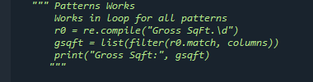
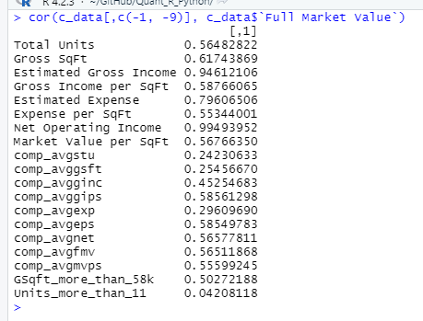
My Data
My data came from the Department of Finance and consisted of 28507 observations and 63 columns
I had to transform the data so I could look at the full market values by neighborhood
Utilized R and Python to clean the data and order the data into Neighborhoods rather than individual observations
After cleaning my data was 287 observations for 21 columns
Finally, I used R to perform the graphing and analysis of the data

Slide 5
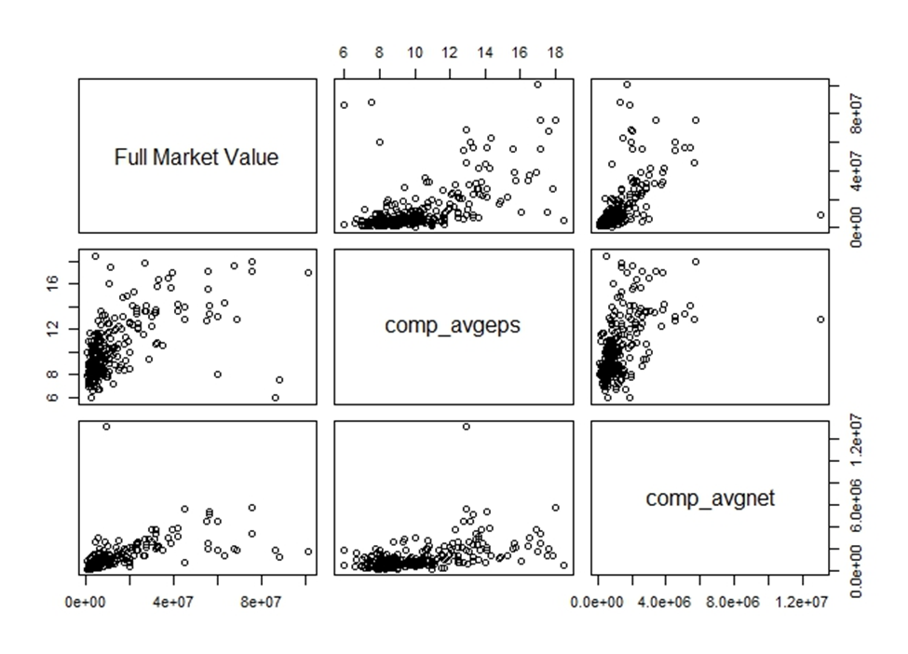
Plots

Slide 6
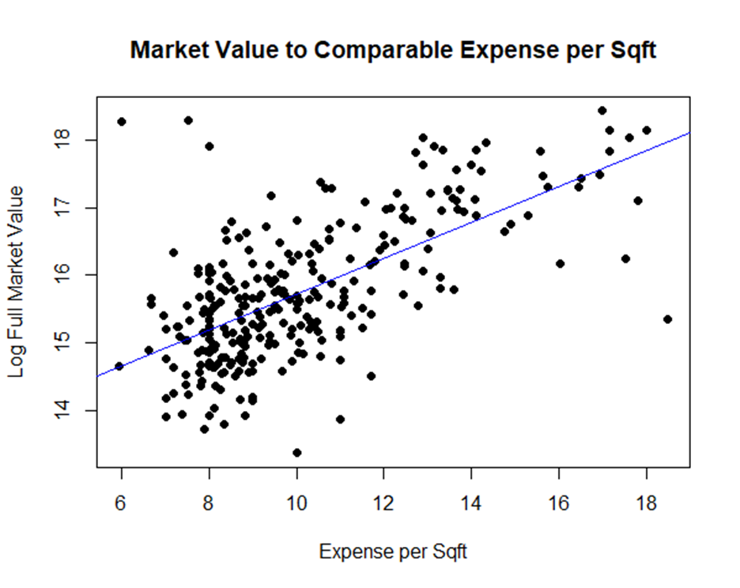
Plots

Slide 7
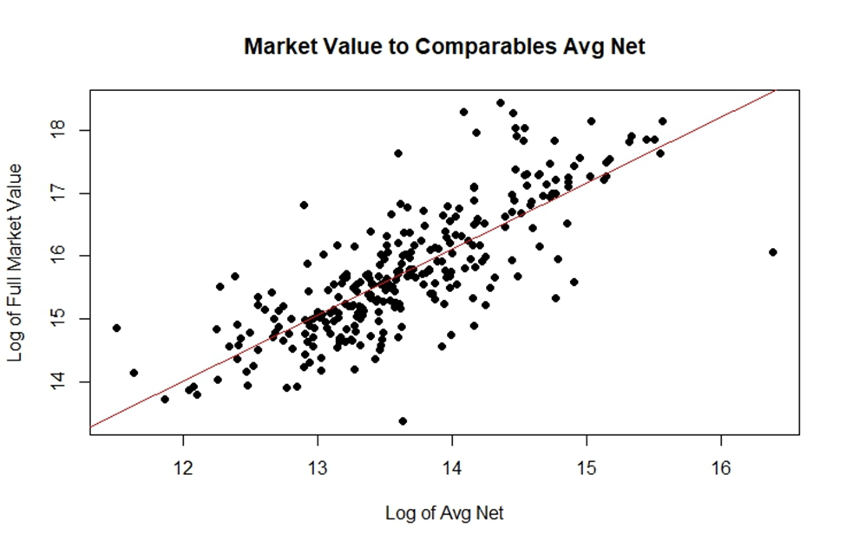
Plots

Slide 8
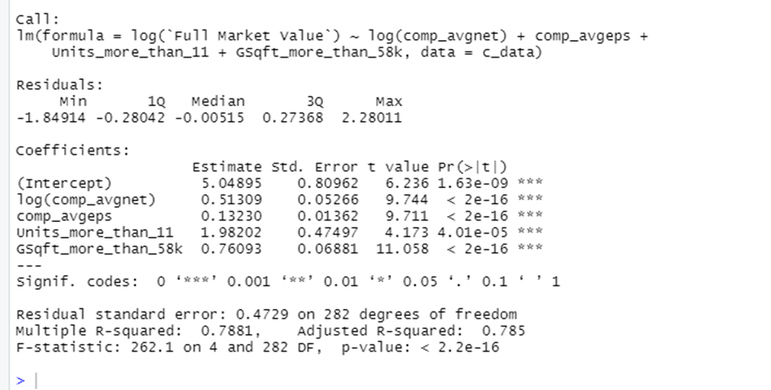
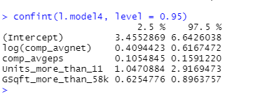
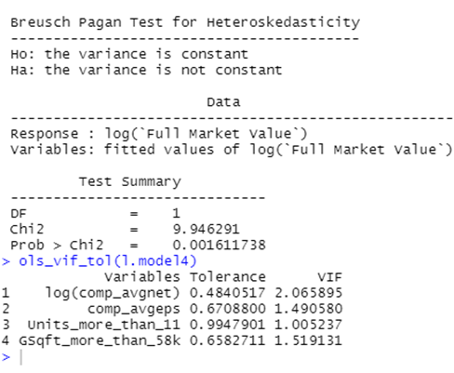
Analysis

Slide 9
Conclusions
As the Comparable Expense per Sqft increases it actually has a positive effect on Market Value
When Net Income of Properties in a neighborhood increases it would lead to an increase of Market Value but it’s not as a big of change as I hoped
Total Units and Area are both important to Market Value!!!
What can we determine?

Slide 10
Any Questions?

